Slide 1

Note: The data and information in this document is reflective of a hypothetical situation and client. This document is to be used for KPMG Virtual Internship purposes only.
Sprocket Central Pty Ltd
Data analytics approach
[Division Name] - [Engagement Manager], [Senior Consultant], [Junior Consultant]

Slide 2
Note: The data and information in this document is reflective of a hypothetical situation and client. This document is to be used for KPMG Virtual Internship purposes only.
Agenda
Data Visualization by Dashboards:
Profit Insight
Purchase trends of customer
Customer segment

Slide 3
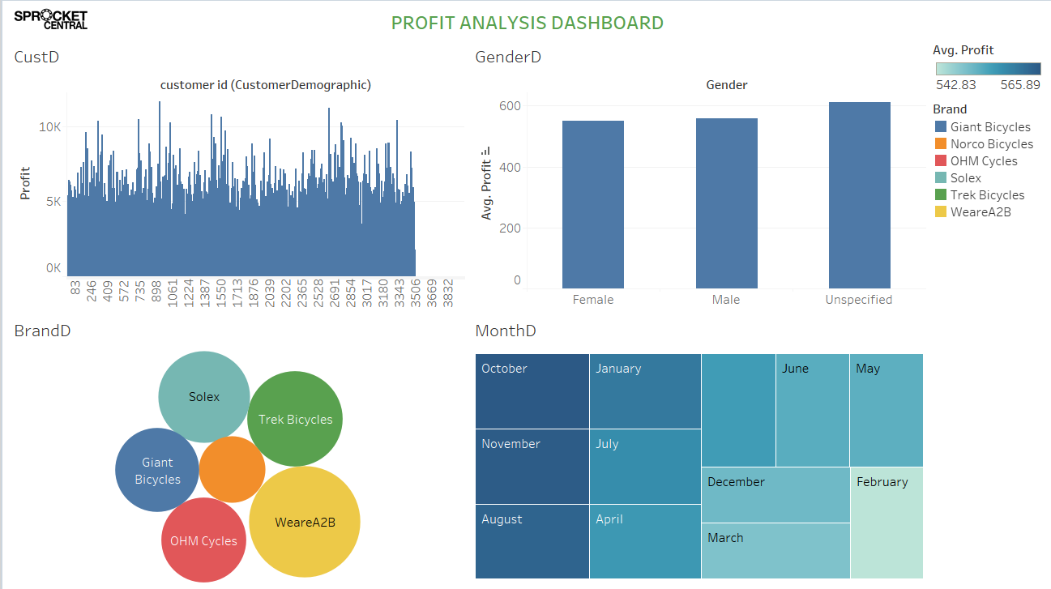
Note: The data and information in this document is reflective of a hypothetical situation and client. This document is to be used for KPMG Virtual Internship purposes only.
Profit Insights
According to the Brand Distribution profit analysis, the WeareA2B brand has give us highest profit in bicycles business.
In Month Distribution analysis has getting insights, and discover month-wise profit pattern of the identify the top three highest profit achieving months are- August, October, and November also.
As per gender distribution profit analysis, unspecified and Male profit ratio more than females customers.

Slide 4
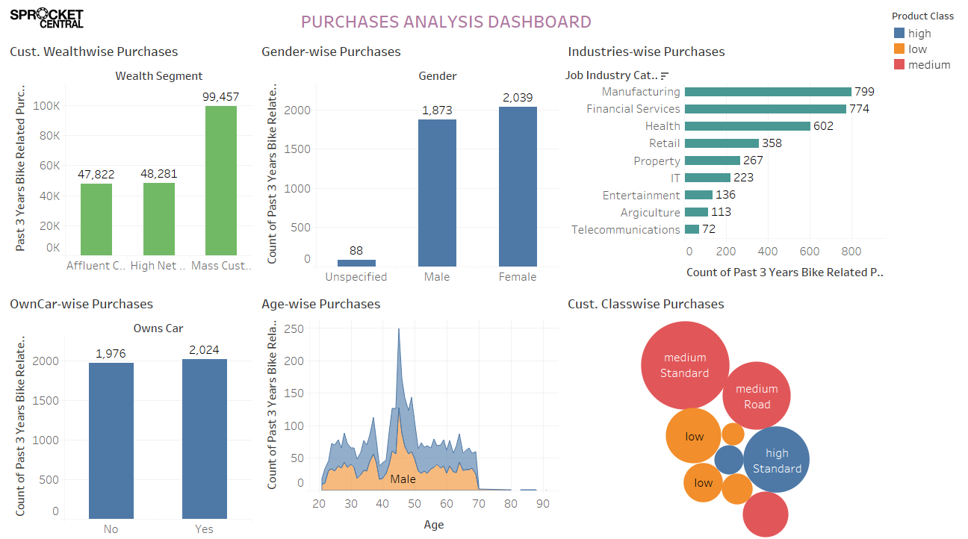
Note: The data and information in this document is reflective of a hypothetical situation and client. This document is to be used for KPMG Virtual Internship purposes only.
Purchase Trend Of Customer
Customer Trend / Patterns:
Discover the industries with the highest purchase ratio, such as Manufacturing, Financial Services, and Health.
The highest purchasing rate of the Mass Customer Segment.
According to gender analysis, the female purchase rate more than male customers.
Owns car customers has higher purchase rate more than not own car customers.
Female cust. has most top purchase rate in 40-50 age group.
Higher Standard product purchasing rate by medium class customers.

Slide 5
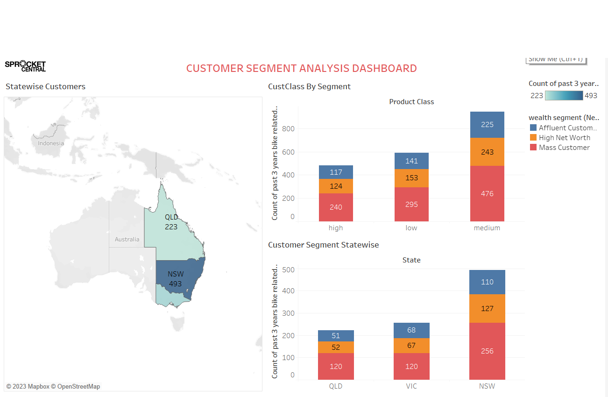
Note: The data and information in this document is reflective of a hypothetical situation and client. This document is to be used for KPMG Virtual Internship purposes only.
Customers Segment
Most of the Customer from Mass Customer Segment, because theirs purchases 476 ratio higher more than other segment customers.
According to map data, our highest customer traffic in the NSW state compared to another states of Australia.
As per state-wise customer segment analysis, we identify our most of the ‘Mass customer segment’ customer come from NSW state, because of their purchasing contribution ratio.

Slide 6
Conclusion
Profit Insight-
One of the most highest profit has given by WeareA2B brand.
In August, October, and November too, we got highest purchases and profit ratio as per data visualization.
As per gender distribution analysis, unspecified and Male customer profit ratio more than females customers.
Purchase trends of customer-
Identify industries with the highest purchase ratio, such as manufacturing, financial services, and health.
In the Mass Customer Segment, we observe the highest purchasing rate.
Gender analysis reveals that female customers have a higher purchase rate than male customers.
Customers who own cars have a higher purchase rate than those who do not own cars.
Among female customers, the 40-50 age group has the highest purchase rate.
In the medium class, most customers purchase more standard-line products than other customers.
Customer Segment Details-
Most customers are from the Mass Customer Segment because their number 476 purchase higher than other segment cust.
As per to the map data, our highest customer traffic is in the NSW state compared to other states in Australia.
Our analysis reveals that the maturity of our 'mass customer segment' customers are from the NSW state in Australia because they make significant purchases.

Slide 7
Note: The data and information in this document is reflective of a hypothetical situation and client. This document is to be used for KPMG Virtual Internship purposes only.
Appendix

Slide 8
Note: The data and information in this document is reflective of a hypothetical situation and client. This document is to be used for KPMG Virtual Internship purposes only.
Appendix
All supporting items in that attachment .

